Slide 1







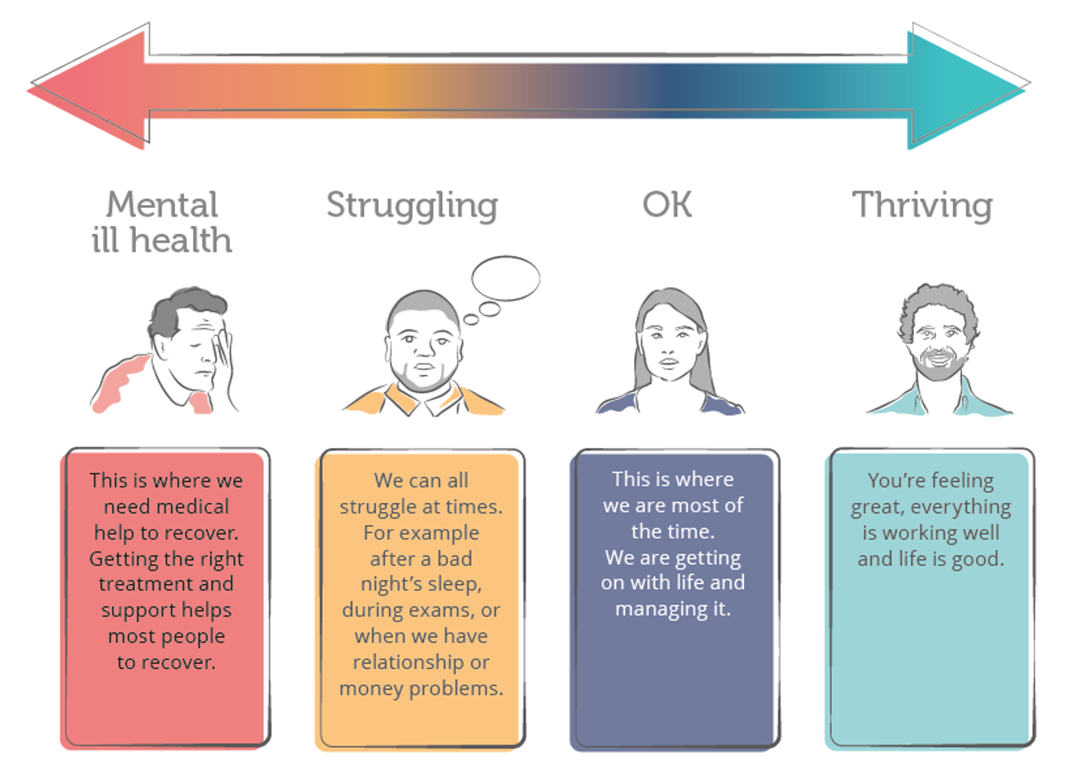
Maritime Wellbeing
What are the signs and states
Too often employees are scared to tell their manager about a mental health problem. As a manager you can take proactive steps to create an open and supportive culture and identify changes in behaviour for yourself or others.
Noticing a change in regular behaviour
Too much sleep or trouble sleeping
Change in appetite
Trouble focussing or having racing thoughts
Irritability or having a short temper
Isolating from others or losing interest in things that were once enjoyed
Just like physical health, mental health changes all the time. Our mental health can be anywhere on this scale at any time.
You move up and down the scale all the time, we all do.
Your state of mental health can change rapidly from day to day, hour to hour, minute to minute; one moment you are struggling and next the problem lifts and you are feeling positive again and vice versa.
We all struggle at times – this is a part of life. It’s good to know what help and support is available to help you to resolve the problems. One in 4 people have a mental illness at some point in their life, such as depression, anxiety etc. These are treatable and with the right support people can get back to normal mental health again.
We are all somewhere on the scale all the time.

Slide 2




Maritime Wellbeing
ALL ACT
ASK
DO:
Find the right time and place
Start right
Give them the ‘space’ to talk
DON’T:
Make assumptions
Diagnose
LOOK
DO:
Be aware of differences in what people say and how they appear
DON’T:
Comment on their appearance
Give up on the conversation if they appear distracted
LISTEN
DO:
Stay focused
Respond flexibly and sensitively
Ask for clarification
Use sensitive language to recap what the person has shared with you
DON’T:
Leave them if they are distressed
ACT
DO:
Let them know you care
Remind them about the help available
Escalate
DON’T:
Make assumptions
Try to ‘diagnose’
CHECK BACK
DO:
Let them know you are open to having another conversation
Agree another time for a catch up to find out how they are doing
DON’T:
Leave it too long to talk again
TAKE CARE OF YOU
DO:
Spend some time taking care of yourself
Use the support systems yourself
DON’T:
Take on responsibility for fixing your co-worker’s problem
Keep your feelings or problems to yourself
For support services or available resources please refer to:
www.maritimewellbeing.com
Insert details from your company here
.
.
.

